Slide 1


Duke Registrar
Recommender System
Vanessa Tang, Sangseok Lee, Yiran Chen
Duke Registrar Recommender
Notes:
Today we are presenting our capstone project on course recommendation system for Duke Registrar.

Slide 2
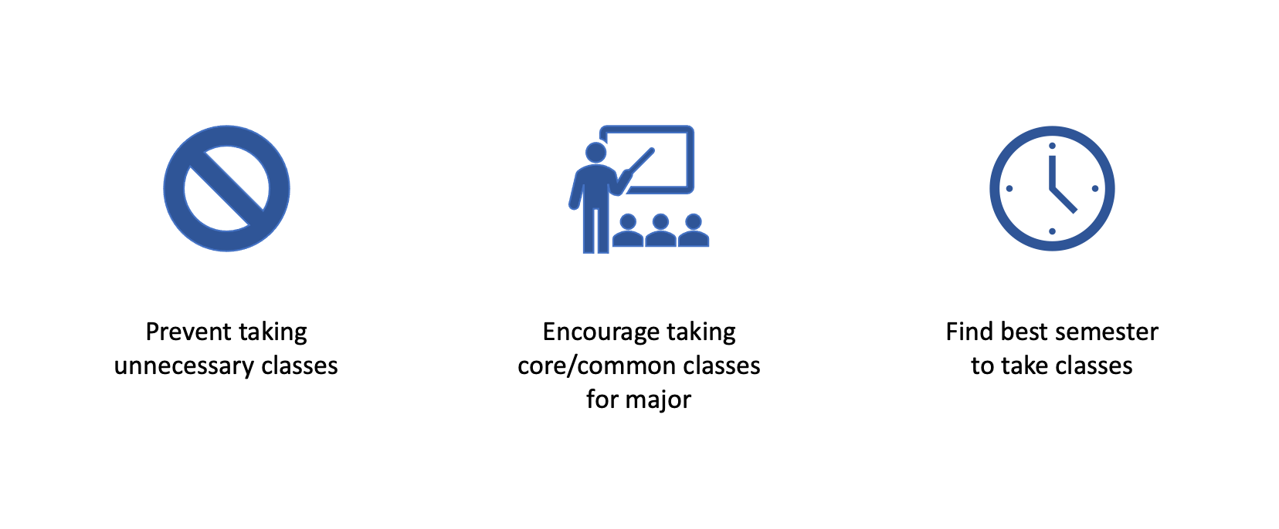
Project Overview
Facilitate course selection
Select and plan classes for major
Duke Registrar Recommender
Notes:
The overall goal is to facilitate course selection for the duke undergraduate students. We aim to help students select and plan classes for their desired major. This is important because it can help prevent students from taking unnecessary classes, encourage them to take core classes, in addition to finding the best time to take a certain class. This helps guide students through major selection in addition to class selection and planning throughout their time at Duke.

Slide 3

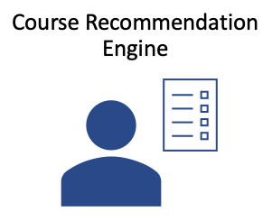
Two Primary Goals
Duke Registrar Recommender
Notes:
Our two primary goals to help facilitate course selection are 1) tracking the academic pathway and 2) developing a course recommendation engine. Today, we’ll be primarily focusing on the idea of an academic pathway. “Academic pathway” can be defined in many ways, but our work aims to determine what classes are commonly taken for each major, when certain classes are taken, and what classes lead to other classes.

Slide 4
Academic Pathway: Major Selection and Course Planning
If a student plans to take one class or a set of classes,
What major are they likely to graduate with?
What classes are important to that major?
When are these classes commonly taken?
Duke Registrar Recommender
Notes:
Imagine its your freshman fall term. You’re enrolled in four classes now, but don’t know what to take next semester. What majors should you consider? What classes should you take? When should you take those classes for your interested major?

Slide 5
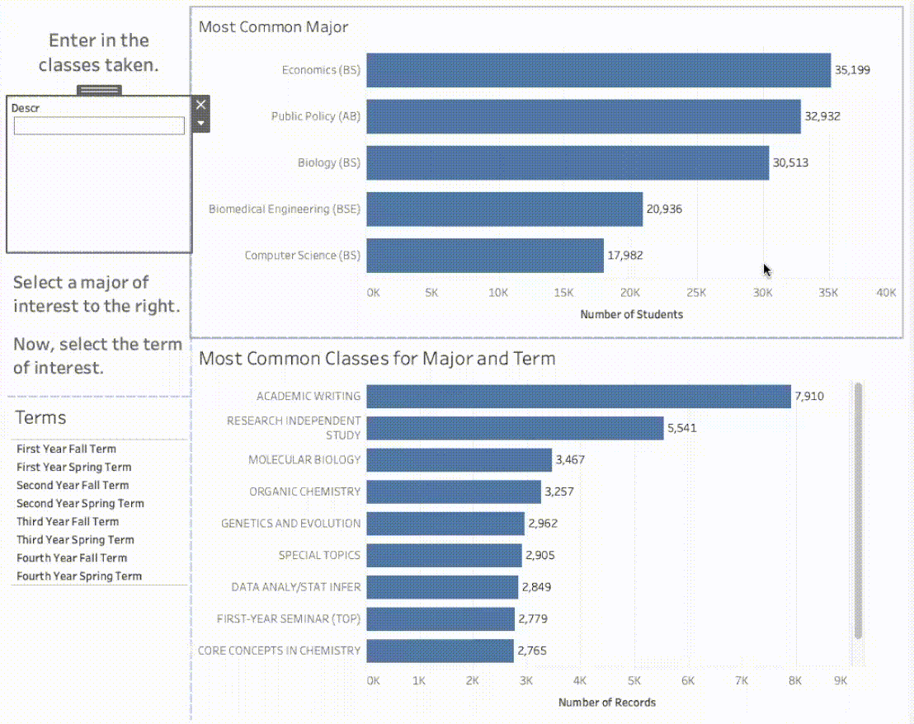
Academic Pathway: Major and Class Selection
Notes:
(demo)
Classes taken: Academic writing, Economic principles, Introductory psychology, Multivariable calculus
Using our dashboard, you can enter the four classes you’ve already taken. Here, its academic writing (a mandatory class for freshmen), economic principles, introductory psychology, and multivariable calculus. The most common major given these classes is econ, so let’s say you’re interested in being an econ major. Now, you can select econ, and then select the term of interest. Since it’s freshman fall, you’re trying to plan classes for the freshman spring term, so you can select that. Now we see the top 10 most common classes for econ majors to take during that term.
You’ve already taken a couple of them, so lets pick a few interesting ones that you haven’t taken: intermediate micro I, multivariable calculus for econ, intro to cs, and probability/statistical inference. Now, we’re not sure if you should take all of them at once. Maybe theres another class - like dance - that you really want to take, so let’s see when would be a good semester to take these four classes. (go to next dash)

Slide 6
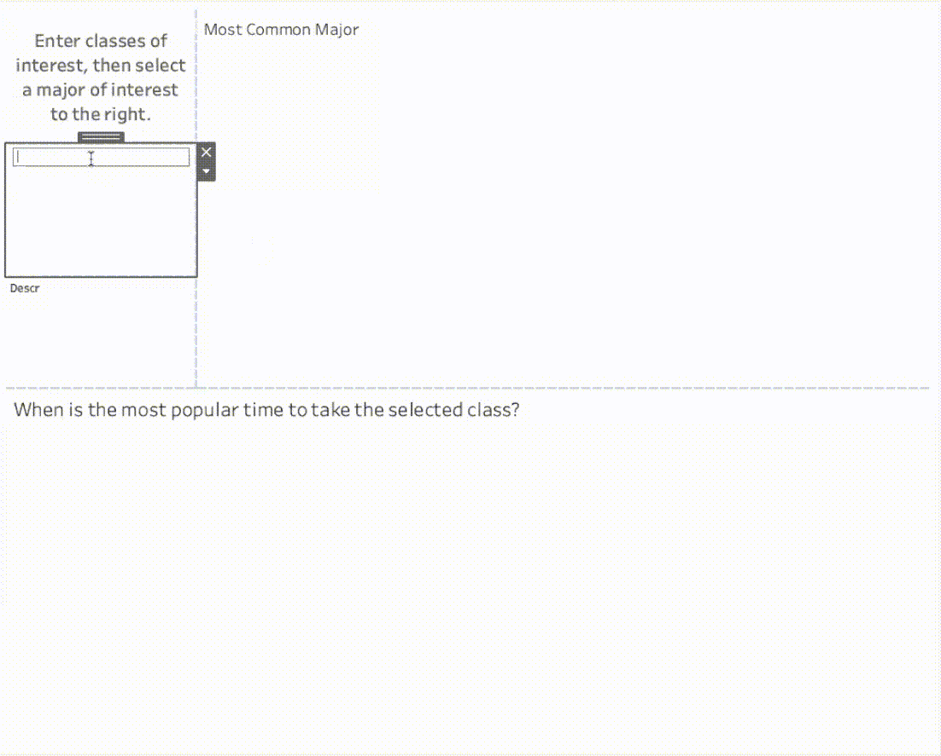
Academic Pathway: Class Planning
Notes:
(demo) Now, to help determine when to take these classes, we can enter them into this dashboard. We can see that the most common major is econ, but with these classes, we can also consider other majors. Let’s say you’re still interested in econ, so we can select econ to just see the course taking pattern for econ students. It looks like microeconomics is most commonly taken sophomore fall term, so we can hold off on taking micro to make space for that dance class you wanted to take.
These dashboards have helped you select a major, find classes to take, and plan when to take these classes.

Slide 7
Academic Pathway: Class to Class
What classes is it common to take next?
Economic Principles
?
?
?
Duke Registrar Recommender
Notes:
Ok. From our previous dashboard, imagine that you chose a major that you are interested in. Then What would be the next question? Next question would be what classes should I take from semester to semster or year to year given the major that I have chosen. (CLICK) For example, after taking economic principles, what should you take next if you are interested in majoring in Economics?

Slide 8
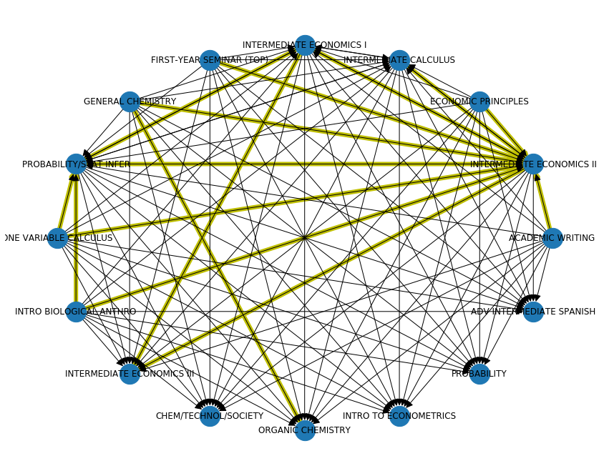
Network Plots
Year 1 to Year 2
: more than 10% of students who took one class moved to the other class
Duke Registrar Recommender
Notes:
In order to track the progression from one class to another, we used network plots. This shows the transition from the most popular classes in year 1 to those in year 2 for econ majors. From this plot, we can identify a few patterns:
First, if you look at the node ‘economic principles’, the yellow line is toward intermediate econ II. Here yellow line represents more than 10% of studenets who took one class moved to the other class, which means a popular transition from year 1 to year 2. (CLICK)
Second, by visualizing the whole network for the most popular classes, we can see how different classes lead to other classes.
By showing the larger network, we can see that Intermediate economics II (CLICK) is a very popular class in year 2. Many students from a variety of different classes end up taking intermediate econ II some time during their 2nd year.

Slide 9
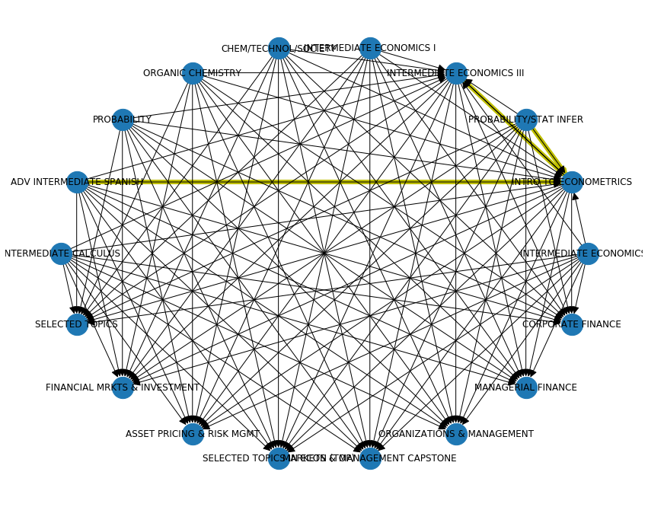
Network Plots
Year 2 to Year 3
: more than 10% of students who took one class moved to the other class
Notes:
And the same network plots from year2 to year3. Compared to the previous plot from year 1 to year2, class transitions are widely dispersed. And most of popular classes are now related to econ major (CLICK) except intermediate spanish and chemistry classes, which is also towards econ classes in year3. Particularly, we have yellow line from Spanish course to intermediate econometrics.
So how do you think? Is this helpful?

Slide 10
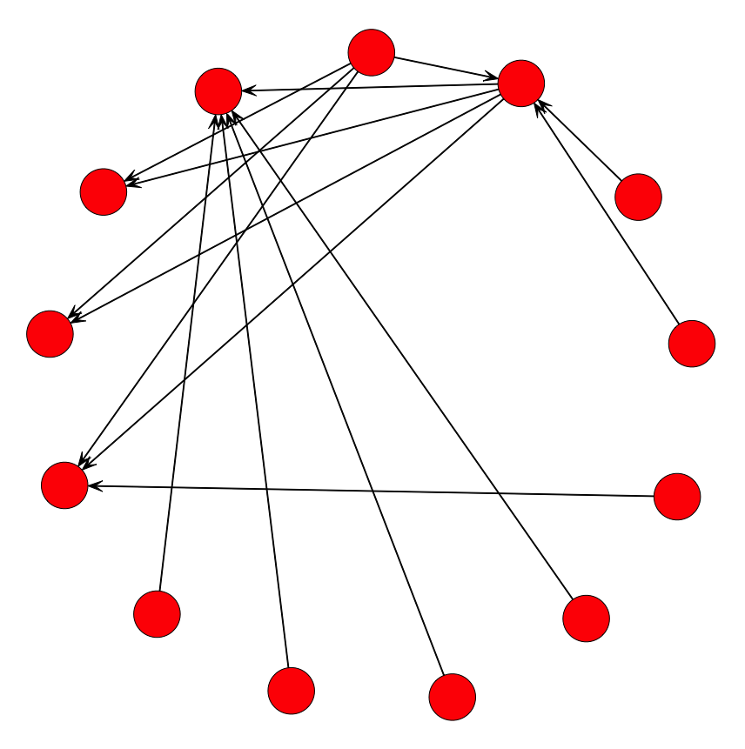
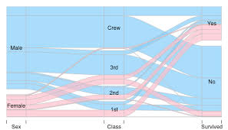
Network Plots: Limitations
Can’t see number of students
Not as clear of a “pathway”
Alluvial Plots: Advantages
Show flow from one state to another
Helps track progression of classes
Duke Registrar Recommender
Notes:
Yes, This network plot is useful, in terms of tracking class transitions from one time to the other.
However, this does not show how many students have taken each class, which does not seem clear to you if you are end-user. (CLICK) So, we created a better plot, it’s called ‘Alluvial Plots’. Alluvial plots also show flow from one state to another. It overcomes some of the limitations of network plots.

Slide 11
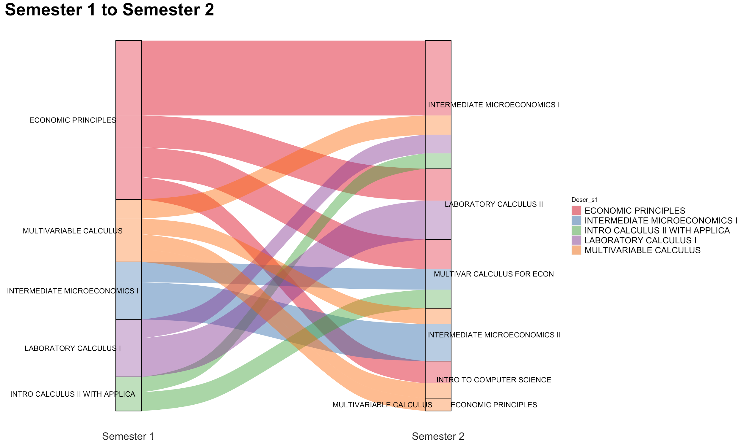
Semester 1 to Semester 2
Notes:
This alluvial plot shows the flow of students from semester 1 to semester 2 for the most popular classes for econ majors. It helps identify pathways and shows popular progressions from one class to the next. In these plots, the width represents the number of students and the colors indicate courses in the first semester.
For example, we can see that many students who take economic principles their first semester take intermediate micro I in their second semester. This indicates that if you’ve already taken economic principles, it would probably be a good idea to consider taking intermediate micro I. Multivariable calculus is a little more split, but the plot still provides some common course options to take next.

Slide 12
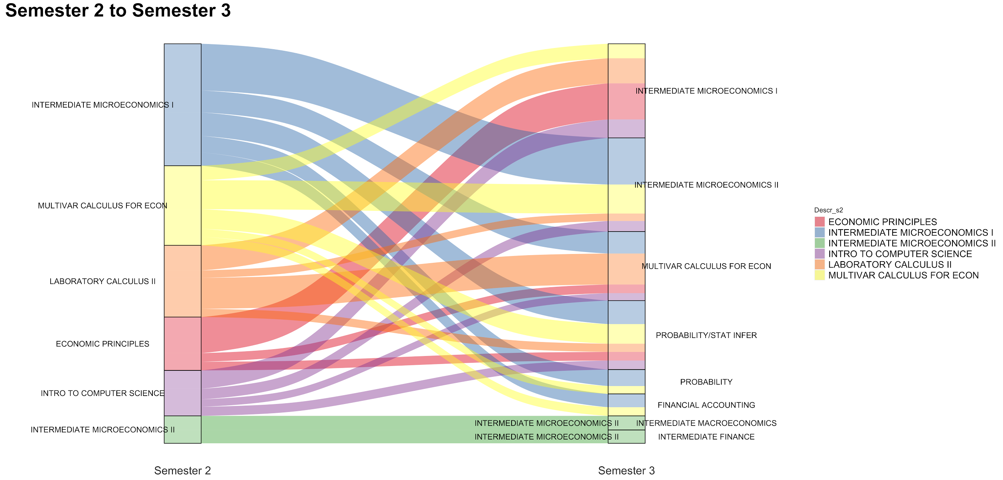
Semester 2 to Semester 3
Notes:
Now we can see the progression of classes for econ majors from semester 2 to semester 3. Again, we see a clear path from intermediate micro 1 to intermediate micro 2. However, these alluvial plots also help show options. For example, after taking micro 1, many students branched out and took multivariable calculus for econ or probability and statistical inference. However, it is uncommon to go from micro 1 to intermediate macro or intermediate finance. Instead, we can see that to take intermediate macro or finance, you should probably take micro 2.
Overall, these alluvial plots can be helpful for students to show popular classes to take next or even classes to avoid taking next.

Slide 13
Alluvial Plots: Future Work
Make interactive
Apply to several semesters at a time
Use grade information
If students did poorly in one class, did they also do poorly in another class?
Do student who do poorly follow a different pattern?
Create pipeline on DSS to facilitate filtering
Grade filtering: A/B/C/D, Pass/Fail
Major filtering
Duke Registrar Recommender
Notes:
Though these alluvial plots are really helpful at tracking pathways and progressions, we are still working on making them interactive and easier for students to use. Furthermore, showing the flow over several semesters can help students track long term pathways. We are also looking to incorporate grade information. This could help identify areas where students struggle and if doing poorly in one class leads to doing poorly in another class. Lastly, we are working with Dataiku to streamline this plotting process to facilitate use for other majors and grade filtering.

Slide 14
Recommender Systems
Neighborhood Methods
User-based + Item-based
2. Latent Factor Methods (Matrix Factorization)
SVD
LightFM
Pros
Popular method for binary data
No domain knowledge needed
Similarity based → more focused
Pros
Able to consider grade (or other user/item features)
Diversity
Cons
Can’t consider multiple features such as grade
Expensive and inefficient to compute the similarity
Cons
Grade ≠ Rating
Hard to interpret
Duke Registrar Recommender
Notes:
For modeling part on the recommender systems, we use two main approaches. First one is item-user based neighborhood method, popularly used for binary data with no need for domain knowledge. It gathers up most similar courses from the student course taking history, which makes the recommended items more focused with respect to the user. On the other hand, however, this method can’t integrate multiple features such as grade information. As it needs to compute a giant item item matrix, it will be very expensive and inefficient to compute and recommend courses in the actual application.
The second method is latent factor models with several variations including Singular Value Decomposition and LightFM. SVD is able to produce predicted grade for a course with respect to the student through matrix factorization. LightFM is a hybrid content-collaborative model which can incorporate metadata of students’ major, minor, course subject and offered year into consideration. Both methods take normalized grade into account as a proxy for ratings, therefore recommending courses with generally higher grades with a larger extent of variability compared to the neighborhood method. However, there are some drawbacks. For one, the latent features are hard to interpret. It should also be noted that grade and rating are not the same thing. Recommending based on grades does not directly link to prediction accuracy on which courses the students take.

Slide 15
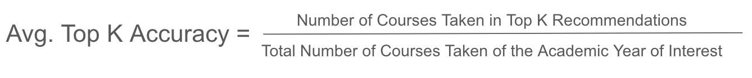
Modeling: Current Work
Goal: Improve prediction accuracy
Methods (in progress)
Preprocessing
Grade normalization based on course
Limit search space: Remove courses taken by fewer than 100 people (total)
Post-processing: business rules
Remove courses not in top 100 most popular courses from recommendations
Duke Registrar Recommender
Notes:
The metric for prediction accuracy we use is calculated as how many recommended courses are successfully captured among the courses students actually took at one particular term.
In order to improve this metric, we have tried some further preprocessing methods. These include grade normalization based on courses, and removing courses that are taken by fewer than 100 students to limit the search space. After getting the recommended items from the model, some post-processing was also tried by removing those that are not in top 100 most popular courses.

Slide 16
Neighborhood Method
Limit search space: Remove courses taken by fewer than 100 students
Improved model performance by an average of 26.8% over 6 semesters
(k = 10) | 2Y Fall | 2Y Spring | 3Y Fall | 3Y Spring | 4Y Fall | 4Y Spring | Average
Before | 25.4% | 22.9% | 9.1% | 6.5% | 14.4% | 46.2% | 20.8%
After | 60.8% | 49.7% | 51.1% | 50.7% | 38.6% | 33.8% | 47.6%
Change | +35.4% | +26.8% | +42% | +44.2% | 24.2% | -12.4% | +26.8%
Duke Registrar Recommender
Notes:
The best performing model we have so far is the neighborhood method based on item-user similarities. After we pre-process the data by removing courses taken by fewer than 100 students, it performs much better, with an average increase in accuracy of about 27%.
Before, the model had low performance with an average accuracy of about 20%. After removing unpopular courses, it achieved up to 60% prediction accuracy. By limiting the search space, neighborhood method is able to obtain generally good prediction performance across almost every semester. Again, we acknowledge that with this measurement of accuracy, we expect a low number because we are trying to capture an average of 4 classes per term.

Slide 17
Conclusion
Major Selection & Course Planning
Class to Class pathway: Network and Alluvial Plot
Neighborhood Method
Latent Factor Method
Duke Registrar Recommender
Notes:
In conclusion, we have created powerful visualizations to represent academic pathways. The dashboard serves as a useful interactive tool for students’ major selections and course planning with a more holistic view, (CLICK) while the network and alluvial plot serve as nice references for course pathways taken by most fellow students at one particular semester or consecutive semesters. On the modeling side, with modifications on data preprocessing and post-processing, the prediction accuracy has increased, particularly for the neighborhood method. We will further investigate into more effective representations for both the academic pathway and the recommendation model itself for better prediction accuracy.

Slide 18
Future Work
Alluvial plots
Interactive: user-friendly
Adaptable: majors, grade
Pre and Post-processing
Evaluation metrics
Accuracy, Relevance, Diversity
Duke Registrar Recommender
Notes:
Over the next few weeks, we aim to make our academic pathway visualizations interactive to make them more user friendly. We also want to enable more filtering such as major and grade, which could be helpful for both students and advisors. (CLICK) Lastly, we hope to improve our recommender system using pre and post processing and look at different evaluation metrics in addition to accuracy such as relevance and diversity, which would provide different information depending on the user’s goal.

Slide 19
Thank you!
Vanessa Tang, Sangseok Lee, Yiran Chen
Duke Registrar Recommender

Slide 20
Appendix

Slide 21
Data: 2013-2020
Multiple columns for each
E.g. Major1, Major2, Minor1, Minor2...
Calculation ID | Subject // Catalog | Descr | Grade | Class Year | Majors // Minors // Certificates // Secondaries | Enrollment // Graduation Year | College
2760.65 | Linguist 103 | Symbolic Logic | 4.0 | Senior | Economics (BS) // Linguistics (AB2) | 2013-2017 | Trinity
Normalize grade with respect to each course
Which year the class is taken in four-year time (proxy for course availability)
Duke Registrar Recommender

Slide 22
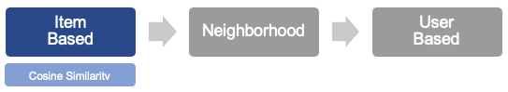
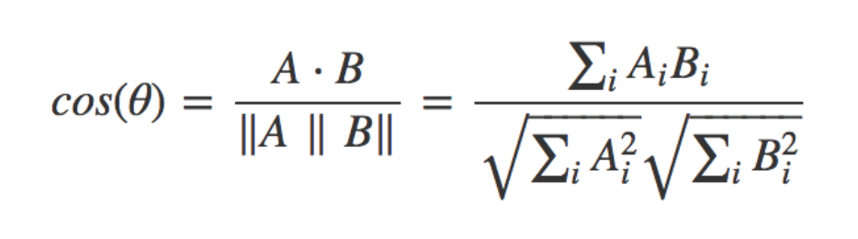
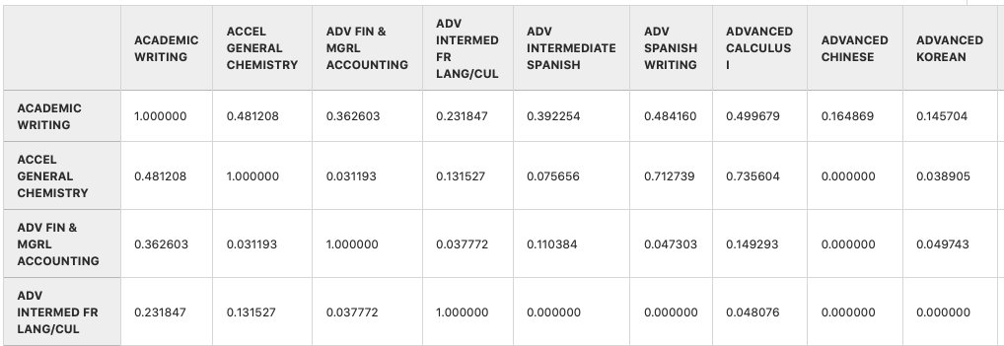
Neighborhood Methods
Duke Registrar Recommender
Notes:
Our collaborative filtering model combines both item and user based methods by creating a “neighborhood” of similar courses. Given our problem, item-based models depend on courses, and user-based models depend on students.
First, we calculate the cosine similarity between courses to construct a new item by item matrix, as shown.
[easier explanation]
you chose one class, let’s say Data to decision, and you want to know what classes are the nearest, which means what other classes are closely related to Data to Decision based on cosine similarity. So using cosine similarity, we now have a list of similar classes with data to decision. This is called item-based method.
However, you want to know what classes other students take, in other words, you wonder other students that have similar pattern just like you. This is called user-based method. So using item-based method with multiple classes, you sort classes by highest similarities.

Slide 23
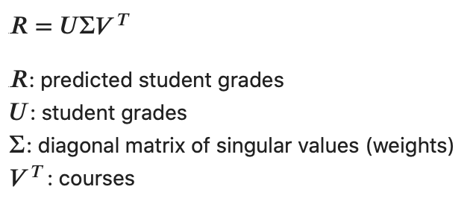
SVD
Singular Value Decomposition (SVD)
Creating training and testing datasets
4 yrs
Train Dataset
Train students
Yrs 1 and 2
Test students
Yrs 3 and 4
Test Dataset
Duke Registrar Recommender
Notes:
Other than neighborhood methods, another popular method commonly used in recommender systems is matrix factorization. One popular algorithm for matrix factorization is called singular value decomposition, where student grades can be predicted by multiplying U (the student grade matrix), sigma (the diagonal matrix of weights), and V transposed (all the courses).
Listening to feedback from others, we decided to try a different train test split method. We first split the students in 80% training students and 20% test students. For the training students, all 4 years of data were added to the training dataset. For the test students, years 1 and 2 were added to the training dataset and years 3 and 4 are left out and considered the test dataset. Thus, the matrix that is fed into SVD contains 4 years of data for 80% of the students and 2 years of data for 20% of the students. We can then test SVD performance on years 3 and 4 from the test students.
Go into factors and find earlier classes that have large weights for later classes
Find earlier classes that determine success/failure in later classes
Look at students who didnt do well
Logistic regression to predict prob of certain classes
Clustering
Decision trees

Slide 24
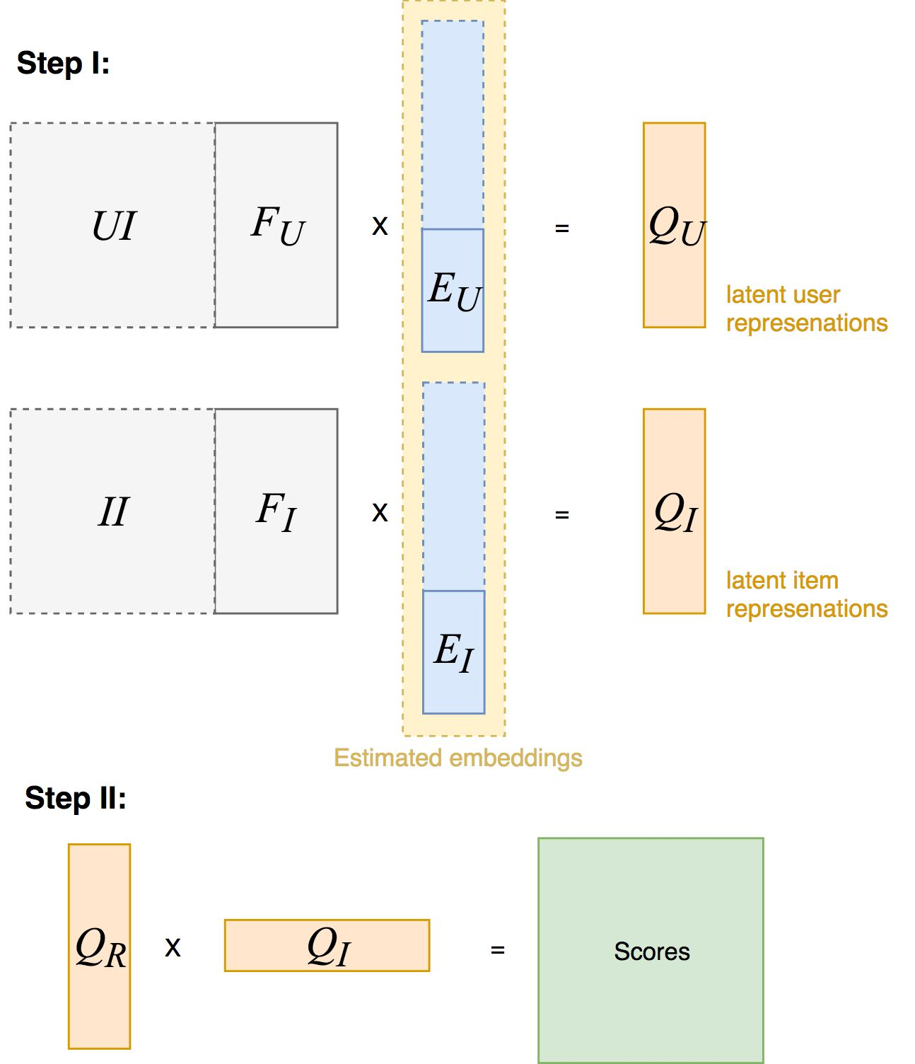
LightFM
User feature:
major, minor
Item feature:
subject, class_year (both multi-hot representation)
Each feature encoded as latent vectors of specified size

Slide 25
Challenges
No information on:
Graduation/Major requirements
Course: prerequisites, availability, ratings, professors
Success metric: career interests
Noise:
Students don’t have to declare until beginning of junior year
Major switching during the process
Time: course order matters
Separated two time frames: No explicit linkage
Duke Registrar Recommender
Notes:
One major challenge in this project is that we do not have graduation and major requirement information, course prerequisite information, course ratings or information about students’ success after graduation.
Another challenge is that students don’t have to declare majors until the beginning of junior year, and they can also change majors many times. This can create noise in the data.
Furthermore, course order matters, and factoring this temporal aspect into a recommender system is challenging.
Lastly, Duke renumbered courses in 2012, splitting our data into 2 time frames. Unfortunately, there is no explicit way to link pre-2012 courses to post-2012 courses.

